Slide 1


P4 Runtime integration with ODL

Slide 2

Traditional Network Equipment
BGP
OSPF
VXLAN
etc.
Switch ASIC API
OS
Switch ASCI API
Closed
Fixed
Proprietary

Slide 3
In The SDN Era
BGP
OSPF
VXLAN
etc.
Remote Control Plane
OpenFlow
Open
Silicon-independent
Fixed
OpenFlow
OpenFlow
OpenFlow
ASIC A API
ASIC B API
ASIC C API
OS
OS
OS
A
B
C

Slide 4
After P4 Generation
BGP
OSPF
VXLAN
etc.
Remote Control Plane
P4 Runtime Agent
P4 Runtime API
Open and silicon-independent
Program-independent
Extended without restarting the control plane
P4 Runtime Agent
Driver
OS

Slide 5

South Channel Compare and Contrast
OpenFlow
P4 Runtime
OpenFlow protocol
gRPC/protoBuf
OpenFlow
HTTP2
TCP
TCP
Client and Server
Client and Server
Controller
Controller
Server
Client
Switch
Switch
Client
Server
It only gives us a way to populate
a set of well-known tables
It is a protocol-independent API, it doesn't
be tied to any specific network protocols
Device discovery
Set pipeline config
etc.
etc.

Slide 6
How to Use P4 Runtime
P4 program
APP
Apps
P4 Compiler
Frontend
ODL
Backend A
Backend B
P4 Runtime Info
P4Plugin
Data-plane A Configuration
Data-plane B Configuration
gRPC Server
gRPC Server
Driver
Driver
bmv2
Tofino

Slide 7
Introduce to P4Plugin in ODL
ODL
L2Switch
RPC/Notification
DataStore
P4Plugin
REST API
Device
Packet
Table
Cluster
Adapter
gRPC Client
Netconf
Switch
Linux OS
gRPC Server
Netconf Server
Driver
Hardware

Slide 8
Packet-In/Out
APP
Apps
RPC/Notification
ODL
P4Plugin
Packet-In
Packet-Out
Switch
Control Plane
gRPC Server
CPU
Driver
Port
Port
Port
Port
Port
Data Plane
Port
Port
Port
Port
Port

Slide 9
Stream Channel
ODL
device id = 1
device id = 2
device id = 3
gRPC Client
Stream channel, bi-directional
Single TCP connection, multiplexing
IP:Port:Device : Stream channel = 1 : 1
Switch
gRPC Server
Device
device id = 1
device id = 2
device id = 3

Slide 10
How to Implement Program Independent
service P4Runtime {
rpc Write(WriteRequest) returns ...
rpc Read(ReadRequest) returns ...
...
}
message WriteRequest {
uint64 device_id = 1;
Uint128 election_id = 2;
repeated Update updates = 3;
}
message Update {
enum Type {
UNSPECIFIED = 0;
INSERT = 1;
MODIFY = 2;
DELETE = 3;
}
Type type = 1;
Entity entity = 2;
}
message Entity {
oneof entity {
TableEntry table_entry = 2;
...
}
}
message TableEntry {
uint32 table_id = 1;
repeated FieldMatch match = 2;
TableAction action = 3;
}
message TableAction {
oneof type {
Action action = 1;
...
}
}
message Action {
uint32 action_id = 1;
message Param {
uint32 param_id = 2;
bytes value = 3;
}
repeated Param params = 4;
}
message FieldMatch {
uint32 field_id = 1;
...
message Exact {
bytes value = 1;
}
message Ternary {
bytes value = 1;
bytes mask = 2;
}
message LPM {
bytes value = 1;
int32 prefix_len = 2;
}
oneof field_match_type {
Exact exact = 2;
Ternary ternary = 3;
LPM lpm = 4;
...
}
}
Map-like message sequences, each message contains an unique ID and a value.
Due to the use of bytes, the value will not be subject to any restrictions.
What about API exposed to SDN Apps?

Slide 11
P4 Runtime Infomation
header_type ethernet_t { ... }
header_type ipv4_t { ... }
header ethernet_t ethernet;
header ipv4_t ipv4;
parser start { ... }
parser parse_ethernet { .. }
action set_nhop(nhop_ipv4, port) { ... }
table ipv4_lpm {
reads {
ipv4.dstAddr : lpm;
}
actions {
set_nhop;
_drop;
}
size: 1024;
}
control ingress {
if(valid(ipv4) and ipv4.ttl > 0) {
apply(ipv4_lpm);
apply(forward);
}
}
tables {
preamble {
id: 33581985
name: "ipv4_lpm"
alias: "ipv4_lpm"
}
match_fields {
id: 1
name: "ipv4.dstAddr"
bitwidth: 32
match_type: LPM
}
action_refs {
id: 16812204
}
action_refs {
id: 16784184
}
action_refs {
id: 16800567
annotations: "@defaultonly()"
}
size: 1024
}
actions {
preamble {
id: 16812204
name: "set_nhop"
alias: "set_nhop"
}
params {
id: 1
name: "nhop_ipv4"
bitwidth: 32
}
params {
id: 2
name: "port"
bitwidth: 9
}
}
actions {
preamble {
id: 16784184
name: "_drop"
alias: "_drop"
}
}
Compile
simple_router.p4
simple_router.proto.txt

Slide 12
ODL & P4 Demo
Simple router based on bmv2
Remote
Chrome
ip:8181
Linux
ODL
P4Plugin
ip:50051
Mininet
Host1
IP : 10.0.0.10/24
Mac: 00:04:00:00:00:00
GW : 10.0.0.1
Static arp:
10.0.0.1 00:aa:bb:00:00:00
bmv2
Host2
IP : 10.0.1.10/24
Mac: 00:04:00:00:00:01
GW : 10.0.1.1
Static arp:
10.0.1.1 00:aa:bb:00:00:01
eth0
2
1
eth0
simple_router.p4

Slide 13
Detailed Steps I
Compile
Start Mininet
hll@hll:/home/opendaylight/p4lang/behavioral-model/mininet$ p4c-bm2-ss simple_router.p4 --p4v 14 -o simple_router.json
simple_router.p4(107): warning: -1: negative value with unsigned type
add_to_field(ipv4.ttl, -1);
^
hll@hll:/home/opendaylight/p4lang/behavioral-model/mininet$ p4c-bm2-ss simple_router.p4 --p4v 14 --p4runtime-file simple_router.proto.txt --p4runtime-format text
simple_router.p4(107): warning: -1: negative value with unsigned type
add_to_field(ipv4.ttl, -1);
^
hll@hll:/home/opendaylight/p4lang/behavioral-model/mininet$
hll@hll:/home/opendaylight/p4lang/behavioral-model/mininet$ sudo python ./1sw_grpc_demo.py --behavioral-exe ../targets/simple_switch_grpc/simple_switch_grpc --cpu-port 64
[sudo] password for hll:
*** Creating network
*** Adding hosts:
h1 h2
*** Adding switches:
s1
*** Adding links:
(h1, s1) (h2, s1)
*** Configuring hosts
h1 h2
*** Starting controller
*** Starting 1 switches
s1 Starting P4 switch s1.
../targets/simple_switch_grpc/simple_switch_grpc --no-p4 -i 1@s1-eth1 -i 2@s1-eth2 --nanolog ipc:///tmp/bm-0-log.ipc --device-id 0 --log-console -- --cpu-port 64
P4 switch s1 has been started.
**********
h1
default interface: eth0 10.0.0.10 00:04:00:00:00:00
**********
**********
h2
default interface: eth0 10.0.1.10 00:04:00:00:00:01
**********
Ready !
*** Starting CLI:
mininet>
Start ODL
hll@hll:/home/opendaylight/odl/new/p4plugin$ ./karaf/target/assembly/bin/karaf
karaf: JAVA_HOME not set; results may vary
Apache Karaf starting up. Press Enter to open the shell now...
100% [==================================================================]
Karaf started in 0s. Bundle stats: 10 active, 10 total
________ ________ .__ .__ .__ __
\_____ \ ______ ____ ____ \______ \ _____ ___.__.| | |__| ____ | |___/ |_
/ | \\____ \_/ __ \ / \ | | \\__ \< | || | | |/ ___\| | \ __\
/ | \ |_> > ___/| | \| ` \/ __ \\___ || |_| / /_/ > Y \ |
\_______ / __/ \___ >___| /_______ (____ / ____||____/__\___ /|___| /__|
\/|__| \/ \/ \/ \/\/ /_____/ \/
Hit '<tab>' for a list of available commands
and '[cmd] --help' for help on a specific command.
Hit '<ctrl-d>' or type 'system:shutdown' or 'logout' to shutdown OpenDaylight.
opendaylight-user@root>feature:install odl-p4plugin-a
odl-p4plugin-adapter odl-p4plugin-all
opendaylight-user@root>feature:install odl-p4plugin-all

Slide 14
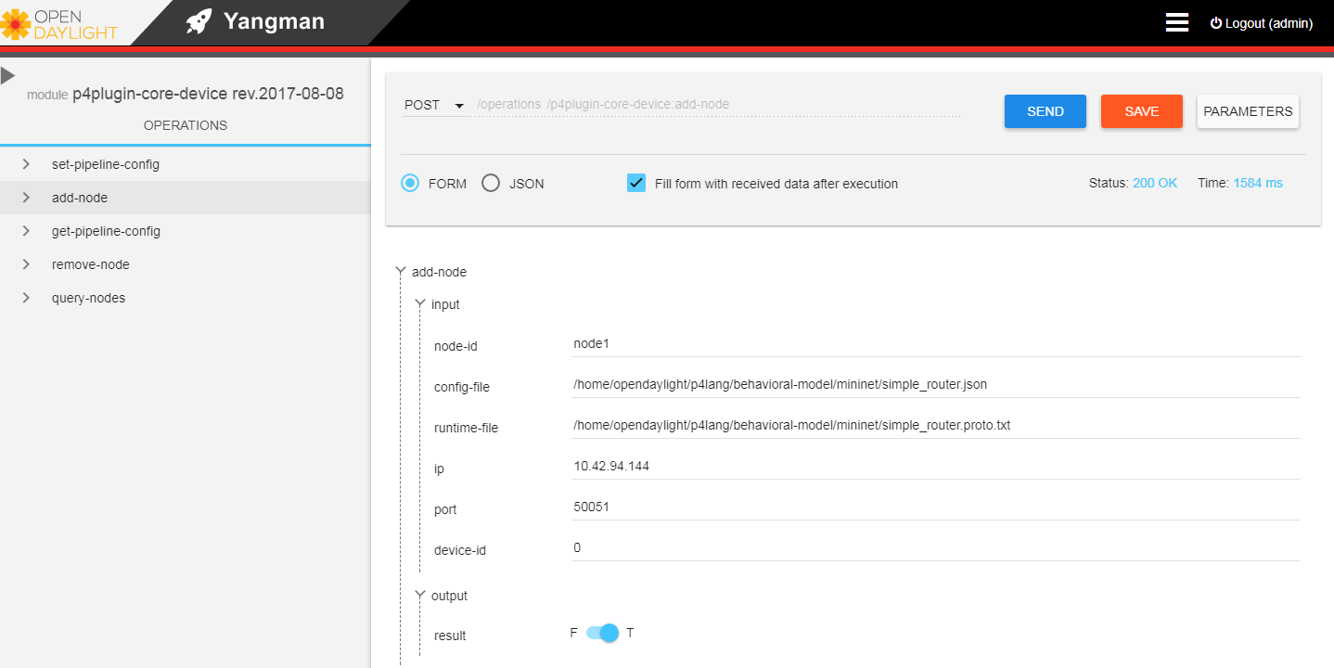
Detailed Steps II
Add node

Slide 15
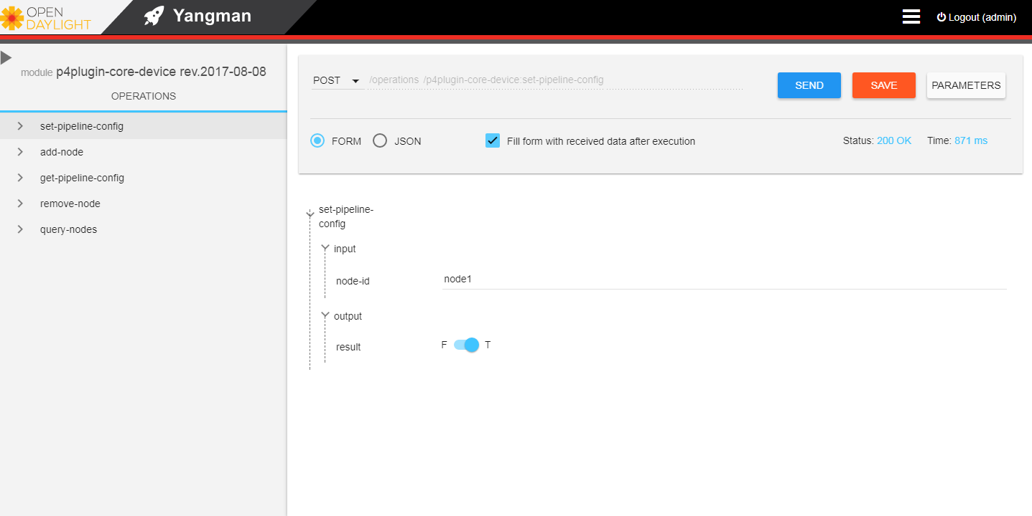
Detailed Steps III
Set pipeline config

Slide 16
Detailed Steps IV
TCP connection
Log
hll@hll:/home/opendaylight/p4lang/behavioral-model/mininet$ netstat -tuan | grep 50051
tcp6 0 0 :::50051 :::* LISTEN
hll@hll:/home/opendaylight/p4lang/behavioral-model/mininet$ netstat -tuan | grep 50051
tcp6 0 0 :::50051 :::* LISTEN
tcp6 0 0 10.42.94.144:38464 10.42.94.144:50051 ESTABLISHED
tcp6 0 0 10.42.94.144:50051 10.42.94.144:38464 ESTABLISHED
hll@hll:/home/opendaylight/p4lang/behavioral-model/mininet$ more /tmp/p4s.s1.log
Thrift port was not specified, will use 9090
Calling target program-options parser
Adding interface s1-eth1 as port 1
[09:50:25.359] [bmv2] [D] [thread 4008] Adding interface s1-eth1 as port 1
Adding interface s1-eth2 as port 2
[09:50:25.425] [bmv2] [D] [thread 4008] Adding interface s1-eth2 as port 2
Server listening on 0.0.0.0:50051
P4Runtime SetForwardingPipelineConfig
[10:11:56.557] [bmv2] [D] [thread 4025] Set default entry for table 'ipv4_lpm': NoAction -
[10:11:56.557] [bmv2] [D] [thread 4025] Set default entry for table 'forward': NoAction -
[10:11:56.557] [bmv2] [D] [thread 4025] Set default entry for table 'send_frame': NoAction -
[10:11:56.559] [bmv2] [D] [thread 4761] [0.0] [cxt 0] Processing packet received on port 1
[10:11:56.559] [bmv2] [D] [thread 4761] [0.0] [cxt 0] Parser 'parser': start
[10:11:56.559] [bmv2] [D] [thread 4761] [0.0] [cxt 0] Parser state 'start' has no switch, going to default next state
[10:11:56.559] [bmv2] [T] [thread 4761] [0.0] [cxt 0] Bytes parsed: 0
[10:11:56.559] [bmv2] [D] [thread 4761] [0.0] [cxt 0] Extracting header 'ethernet'
[10:11:56.559] [bmv2] [D] [thread 4761] [0.0] [cxt 0] Parser state 'parse_ethernet': key is 86dd
[10:11:56.559] [bmv2] [T] [thread 4761] [0.0] [cxt 0] Bytes parsed: 14
[10:11:56.559] [bmv2] [T] [thread 4761] [0.0] [cxt 0] Skipping checksum 'cksum' verification because target field invalid
[10:11:56.559] [bmv2] [D] [thread 4761] [0.0] [cxt 0] Parser 'parser': end
[10:11:56.559] [bmv2] [D] [thread 4761] [0.0] [cxt 0] Pipeline 'ingress': start
[10:11:56.559] [bmv2] [T] [thread 4761] [0.0] [cxt 0] simple_router.p4(153) Condition "and" is false
[10:11:56.559] [bmv2] [D] [thread 4761] [0.0] [cxt 0] Pipeline 'ingress': end
[10:11:56.559] [bmv2] [D] [thread 4761] [0.0] [cxt 0] Egress port is 0
[10:11:56.559] [bmv2] [D] [thread 4762] [0.0] [cxt 0] Pipeline 'egress': start
[10:11:56.559] [bmv2] [T] [thread 4762] [0.0] [cxt 0] Applying table 'send_frame'
[10:11:56.559] [bmv2] [D] [thread 4762] [0.0] [cxt 0] Looking up key:
* standard_metadata.egress_port: 0000
Captured packet
hll@hll:/home/opendaylight/p4lang/behavioral-model/mininet$ sudo tcpdump -i lo port 50051
tcpdump: listening on lo, link-type EN10MB (Ethernet), capture size 262144 bytes
11:22:33.475071 IP 10.42.94.144.38464 > 10.42.94.144.50051: Flags [S], seq 2577324257 ...
11:22:33.475088 IP 10.42.94.144.50051 > 10.42.94.144.38464: Flags [S.], seq 3272263691 ...
11:22:33.475101 IP 10.42.94.144.38464 > 10.42.94.144.50051: Flags [.], ack 1, win 86, ... length 0
11:22:33.475375 IP 10.42.94.144.50051 > 10.42.94.144.38464: Flags [P.], seq 1:28, ack 1 ... length 27
11:22:33.475387 IP 10.42.94.144.38464 > 10.42.94.144.50051: Flags [.], ack 28... length 0
11:22:33.478076 IP 10.42.94.144.38464 > 10.42.94.144.50051: Flags [P.], seq 1:71, ack 28 ... length 70
11:22:33.478089 IP 10.42.94.144.50051 > 10.42.94.144.38464: Flags [.], ack 71 ... length 0
11:22:33.478180 IP 10.42.94.144.50051 > 10.42.94.144.38464: Flags [P.], seq 28:37, ack 71 ... length 9
11:22:33.479914 IP 10.42.94.144.38464 > 10.42.94.144.50051: Flags [P.], seq 71:80, ack 37 ... length 9
11:22:33.482040 IP 10.42.94.144.38464 > 10.42.94.144.50051: Flags [P.], seq 80:208, ack 37... length 128
11:22:33.482076 IP 10.42.94.144.50051 > 10.42.94.144.38464: Flags [.], ack 208 ... length 0

Slide 17
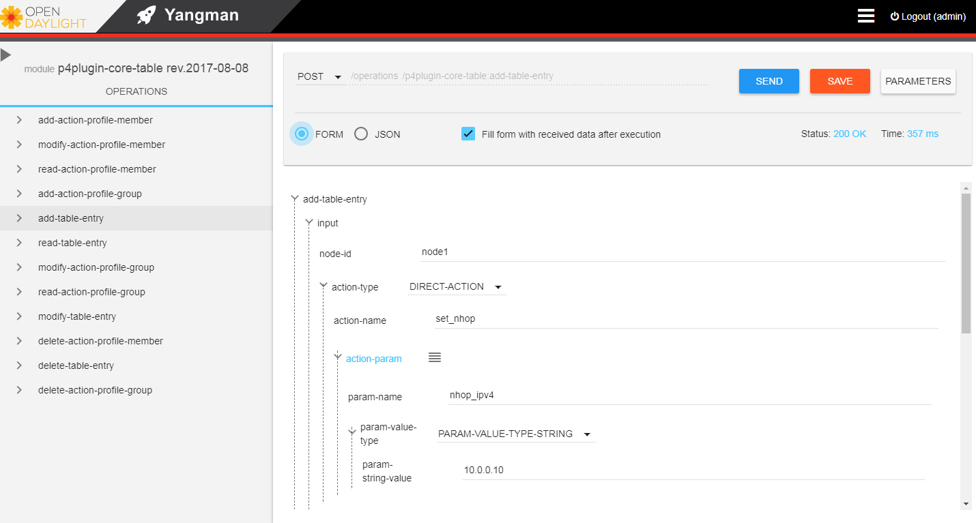
Detailed Steps IV
Add table entry (Form format)

Slide 18
Detailed Steps IV (continued)
Json format
Data
{
"add-table-entry": {
"input": {
"node-id": "node1",
"action-name": "set_nhop",
"action-param": [
{
"param-name": "port",
"param-string-value": "1"
},
{
"param-name": "nhop_ipv4",
"param-string-value": "10.0.0.10"
}
],
"priority": "0",
"controller-metadata": "0",
"table": "ipv4_lpm",
"field": [
{
"field-name": "ipv4.dstAddr",
"lpm-string-value": "10.0.0.0",
"lpm-prefixLen": "24"
}
]
}
}
}
P4Runtime Write
updates {
type: INSERT
entity {
table_entry {
table_id: 33581985
match {
field_id: 1
lpm {
value: "\n\000\000\000"
prefix_len: 24
}
}
action {
action {
action_id: 16812204
params {
param_id: 2
value: "\000\001"
}
params {
param_id: 1
value: "\n\000\000\n"
}
}
}
controller_metadata: 0
}
}
}

Slide 19
Detailed Steps V
Ping test
Match key:
* ipv4.dstAddr : LPM 0a000100/24
Action entry: set_nhop - a00010a,2,
[15:57:51.604] [bmv2] [D] [thread 27525] [25.0] [cxt 0] Action entry is set_nhop - a00010a,2,
[15:57:51.604] [bmv2] [T] [thread 27525] [25.0] [cxt 0] Action set_nhop
[15:57:51.604] [bmv2] [T] [thread 27525] [25.0] [cxt 0] simple_router.p4(104) Primitive nhop_ipv4, port) { ...
[15:57:51.604] [bmv2] [T] [thread 27525] [25.0] [cxt 0] simple_router.p4(104) Primitive port) { ...
[15:57:51.604] [bmv2] [T] [thread 27525] [25.0] [cxt 0] simple_router.p4(107) Primitive add_to_field(ipv4.ttl, -1)
[15:57:51.604] [bmv2] [T] [thread 27525] [25.0] [cxt 0] Applying table 'forward'
[15:57:51.604] [bmv2] [D] [thread 27525] [25.0] [cxt 0] Looking up key:
* routing_metadata.nhop_ipv4: 0a00010a
[15:57:51.604] [bmv2] [D] [thread 27525] [25.0] [cxt 0] Table 'forward': hit with handle 1
[15:57:51.604] [bmv2] [D] [thread 27525] [25.0] [cxt 0] Dumping entry 1
Match key:
* routing_metadata.nhop_ipv4: EXACT 0a00010a
Action entry: set_dmac - 400000001,
[15:57:51.604] [bmv2] [D] [thread 27525] [25.0] [cxt 0] Action entry is set_dmac - 400000001,
[15:57:51.604] [bmv2] [T] [thread 27525] [25.0] [cxt 0] Action set_dmac
[15:57:51.604] [bmv2] [T] [thread 27525] [25.0] [cxt 0] simple_router.p4(121) Primitive dmac) { ...
[15:57:51.604] [bmv2] [D] [thread 27525] [25.0] [cxt 0] Pipeline 'ingress': end
[15:57:51.604] [bmv2] [D] [thread 27525] [25.0] [cxt 0] Egress port is 2
[15:57:51.604] [bmv2] [D] [thread 27528] [25.0] [cxt 0] Pipeline 'egress': start
[15:57:51.604] [bmv2] [T] [thread 27528] [25.0] [cxt 0] Applying table 'send_frame'
[15:57:51.604] [bmv2] [D] [thread 27528] [25.0] [cxt 0] Looking up key:
* standard_metadata.egress_port: 0002
[15:57:51.604] [bmv2] [D] [thread 27528] [25.0] [cxt 0] Table 'send_frame': hit with handle 1
[15:57:51.604] [bmv2] [D] [thread 27528] [25.0] [cxt 0] Dumping entry 1
Match key:
* standard_metadata.egress_port: EXACT 0002
Action entry: rewrite_mac - 10203040506,
[15:57:51.604] [bmv2] [D] [thread 27528] [25.0] [cxt 0] Action entry is rewrite_mac - 10203040506,
[15:57:51.604] [bmv2] [T] [thread 27528] [25.0] [cxt 0] Action rewrite_mac
[15:57:51.604] [bmv2] [T] [thread 27528] [25.0] [cxt 0] simple_router.p4(136) Primitive smac) { ...
[15:57:51.604] [bmv2] [T] [thread 27528] [25.0] [cxt 0] simple_router.p4(138) Primitive modify_field(standard_metadata.egress_port, 2)
[15:57:51.604] [bmv2] [D] [thread 27528] [25.0] [cxt 0] Pipeline 'egress': end
[15:57:51.604] [bmv2] [D] [thread 27528] [25.0] [cxt 0] Deparser 'deparser': start
[15:57:51.604] [bmv2] [D] [thread 27528] [25.0] [cxt 0] Updating checksum 'cksum'
[15:57:51.604] [bmv2] [D] [thread 27528] [25.0] [cxt 0] Deparsing header 'ethernet'
[15:57:51.604] [bmv2] [D] [thread 27528] [25.0] [cxt 0] Deparsing header 'ipv4'
[15:57:51.604] [bmv2] [D] [thread 27528] [25.0] [cxt 0] Deparser 'deparser': end
[15:57:51.604] [bmv2] [D] [thread 27530] [25.0] [cxt 0] Transmitting packet of size 98 out of port 2
*** Starting CLI:
mininet>
mininet> pingall
*** Ping: testing ping reachability
h1 -> h2
h2 -> h1
*** Results: 0% dropped (2/2 received)
mininet> h1 ping h2 -c 4
PING 10.0.1.10 (10.0.1.10) 56(84) bytes of data.
64 bytes from 10.0.1.10: icmp_seq=1 ttl=63 time=1.32 ms
64 bytes from 10.0.1.10: icmp_seq=2 ttl=63 time=1.42 ms
64 bytes from 10.0.1.10: icmp_seq=3 ttl=63 time=2.07 ms
64 bytes from 10.0.1.10: icmp_seq=4 ttl=63 time=1.14 ms
--- 10.0.1.10 ping statistics ---
4 packets transmitted, 4 received, 0% packet loss, time 3004ms
rtt min/avg/max/mdev = 1.149/1.494/2.070/0.347 ms
Packet processing log
[15:57:51.603] [bmv2] [D] [thread 27525] [25.0] [cxt 0] Processing packet received on port 1
[15:57:51.603] [bmv2] [D] [thread 27525] [25.0] [cxt 0] Parser 'parser': start
[15:57:51.603] [bmv2] [D] [thread 27525] [25.0] [cxt 0] Parser state 'start' has no switch, going to default next state
[15:57:51.603] [bmv2] [T] [thread 27525] [25.0] [cxt 0] Bytes parsed: 0
[15:57:51.603] [bmv2] [D] [thread 27525] [25.0] [cxt 0] Extracting header 'ethernet'
[15:57:51.603] [bmv2] [D] [thread 27525] [25.0] [cxt 0] Parser state 'parse_ethernet': key is 0800
[15:57:51.603] [bmv2] [T] [thread 27525] [25.0] [cxt 0] Bytes parsed: 14
[15:57:51.603] [bmv2] [D] [thread 27525] [25.0] [cxt 0] Extracting header 'ipv4'
[15:57:51.603] [bmv2] [D] [thread 27525] [25.0] [cxt 0] Parser state 'parse_ipv4' has no switch, going to default next state
[15:57:51.603] [bmv2] [T] [thread 27525] [25.0] [cxt 0] Bytes parsed: 34
[15:57:51.603] [bmv2] [D] [thread 27525] [25.0] [cxt 0] Verifying checksum 'cksum': true
[15:57:51.603] [bmv2] [D] [thread 27525] [25.0] [cxt 0] Parser 'parser': end
[15:57:51.603] [bmv2] [D] [thread 27525] [25.0] [cxt 0] Pipeline 'ingress': start
[15:57:51.603] [bmv2] [T] [thread 27525] [25.0] [cxt 0] simple_router.p4(153) Condition "and" is true
[15:57:51.603] [bmv2] [T] [thread 27525] [25.0] [cxt 0] Applying table 'ipv4_lpm'
[15:57:51.604] [bmv2] [D] [thread 27525] [25.0] [cxt 0] Looking up key:
* ipv4.dstAddr : 0a00010a
[15:57:51.604] [bmv2] [D] [thread 27525] [25.0] [cxt 0] Table 'ipv4_lpm': hit with handle 1
[15:57:51.604] [bmv2] [D] [thread 27525] [25.0] [cxt 0] Dumping entry 1

Slide 20
ODL & P4 Demo
Packet in/out based on bmv2
packet_io.p4
#define CPU_PORT 64
parser start {
return ingress;
}
action redirect() {
modify_field(standard_metadata.egress_spec, CPU_PORT);
}
table t_redirect {
actions { redirect; }
default_action: redirect();
}
control ingress {
apply(t_redirect);
}
control egress { }
Remote
Chrome
ip:8181
Linux
ODL
P4Plugin
Packet-In
Packet-Out
ip:50051
Mininet
bmv2
eth0
2
1
eth0
packet_io.p4

Slide 21
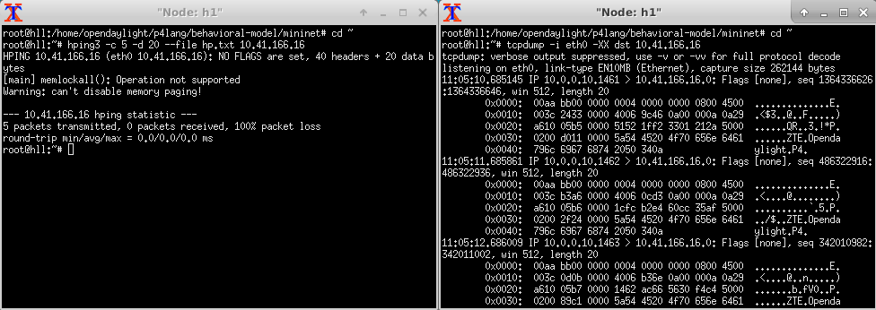
Detailed Steps I
Packet in
Transmit and Capture
Receive log

Slide 22
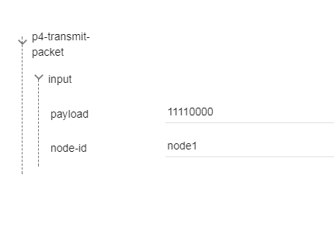
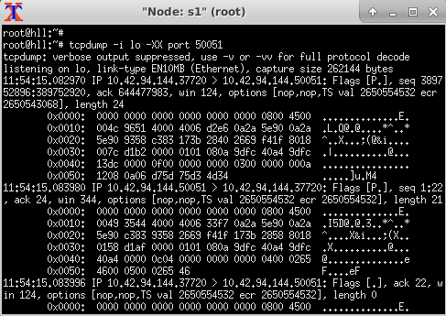

Detailed Steps II
Packet out
Transmit and Capture
YangUI
* “11110000” base64 decode = d75d75d34d34
Receive log

Slide 23
Thank you.

